Slide 1
Conscious Discipline
Tier I Behavior Management at Galileo School for Gifted Learning, 2013-2014

Slide 2
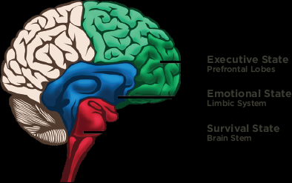
Brain State Model
Brain Stem: Survival State
Children and adults who are “living in” (thinking, reacting with) their brain stem are in a constant state of fight or flight. They need to know, “Am I safe?”
The only way to soothe the survival state is through the creation of safety.

Slide 3
Brain State Model
Limbic System: Emotional State
Children and adults who are “living in” (thinking, reacting with) their limbic system usually feel that they are victims of the world not “going their way.” They are looking for love and assurance, but they are unable to see the world from another’s point of view. They go on verbal auto-pilot and say things without thinking. They want to know, “Am I loved?”
Most adults in an emotional state revert to disciplining the way they were disciplined, even if they know these behaviors are hurtful or ineffective.
The only way to soothe the emotional state is through connection.

Slide 4
Brain State Model
Prefrontal Lobes: Executive State
Children and adults who are “living in” (thinking, reacting with) their executive state are relaxed and alert. They are empowered to change and make wise choices.
Adults who are in the Executive State are free from past conditioning and attuned to their feelings. They are much more prepared to use effective choices in discipline.
The Executive State is the optimal state for problem-solving and learning.

Slide 5
Conscious Discipline…
Empowers us to be conscious of brain-body states in ourselves and children.
Provides us with the practical skills we need to manage our thoughts, feeling and actions.
Gives us the ability to self-regulate and allows us to teach children to do the same.
Gives us the power to help children who are physically aggressive (survival state) or verbally aggressive (emotional state) become more integrated so they can learn and use problem-solving skills (executive state).

Slide 6
When we understand the brain state model, we can clearly see the importance of building our school on the core principles of safety, connection and problem-solving.
Bailey, B. Conscious Discipline Brain State Model. Loving Guidance, Inc. 2013. Web. 7 Aug. 2008.
<http://consciousdiscipline.com/about/brain_state_model.asp>

Slide 7
Seven Skills of Discipline
The seven skills teach you to respond to conflict in a way that helps children move from the resistant, lower centers of their brain to the more cooperative, higher centers.

Slide 8
Seven Skills of Discipline: Composure
Power of Perception
No one can make you angry without your permission
Be a S.T.A.R.! Stop (Smile), Take a deep breath, And Relax

Slide 9
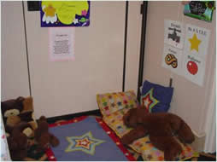
Seven Skills of Discipline: Composure
Safe Place
Purpose: To provide a learning center in the classroom where children can go to change their inner state from upset to peaceful and composed in order to optimize learning.
When a child might use the safe place:
Missing a parent/guardian
Overwhelmed with class events
Frustrated with social conflicts
Sadness over life events (death, divorce, sick relative/pet)
Anger over classroom responsibilities and expectations
Disappointed with outcomes (no permission slip = no field trip)
Tired from lack of sleep
Bad day for unexplained reasons
Just need a moment
Safe Place agreements:
Anyone can choose to go to the Safe Place at any time.
The adult can suggest that the Safe Place would be beneficial.
Friends can suggest you go to the Safe Place.
One person in the Safe Place at a time.
If you are in the Safe Place and someone else needs the Safe Place, be willing to solve the problem.

Slide 10
Seven Skills of Discipline: Encouragement
Power of Unity
We are all in this together.
Encouraging language: “You ______________ so ___________. That was so helpful!” (Example: You pushed your chair in so Johnny wouldn’t trip on it when he walked by. That was so helpful!”

Slide 11
Seven Skills of Discipline: Encouragement
Family and Friends Board/Book
Job Board
Examples of jobs for Job Board
Secretary Greeter Messenger Line Leader
Line Helper Researcher Electrician Door Holder
Snack Helper Lunch Helper Floor/Wall Monitor
Book Monitor Fixer Playground Helper
First Aid Giver Encourager Morning Message
Pet Caregiver Cubby Checker Kindness Recorder
Goodbye Wisher

Slide 12
Seven Skills of Discipline: Assertiveness
Power of Attention
What you focus on, you get more out of.
Assertive language: “Did you like it? Go tell ________, ‘I don’t like it when you ___________. Please ______.’” (Example: “Did you like it? Go tell Johnny, ‘I don’t like it when you yell at me. Please use a gentle voice when you talk to me.”

Slide 13
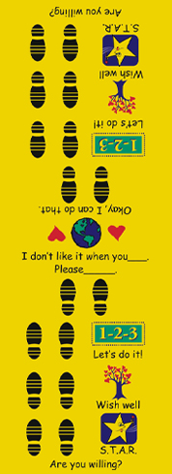
Seven Skills of Discipline: Assertiveness
Time Machine
How it works:
Speaker Steps | Listener Steps
Step 1:
Ask for willingness, “Are you willing to solve the problem?” If no, “When would be a good time?” | Acknowledging “Yes” or “No”
Step 2:
“I don’t like it when you ______” | Mirror: “So you don’t like it when I ______.”
Step 3:
“What I want is _______.” | “Okay I can do that.”
Step 4:
“You can count on me.” + handshake | “You can count on me.” + handshake

Slide 14
Seven Skills of Discipline: Choices
Power of Free Will
The only person you can “make” change is yourself.
Choice language: “You may _______ or ______. What’s best for you?” (Example: You may sit quietly in your chair to finish your work or you may sit quietly on the floor to finish your work. What’s best for you?”

Slide 15
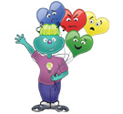
Seven Skills of Discipline: Empathy
Power of Acceptance
The moment is as it is.
Empathetic language: “You seem _________. Something happened?” (Example: You seem angry. Your face is going like this, and your arms are doing this. Something happened?”)

Slide 16
Seven Skills of Discipline: Positive Intent
Power of Love
See the best in others.
Positive language: “You wanted _____. You may not ______. _______ hurts. When you want _____ say or do _______.” (Example: “You wanted the line to move faster. You may not push and shove people to make the line move faster. Pushing and shoving people hurts. When you want to get the line to move faster, say, ‘Please move faster.’”

Slide 17
Seven Skills of Discipline: Positive Intent
Celebrations!
We celebrate achievements that may seem small to us but can be huge to a student!
Celebrate each child’s unique talents, accomplishments, and events. The mort important thing about celebrations is to use it to notice all of the diverse talents and events in your children’s lives, from making a rap song, to an “A” on a math test, to learning to tie shoes. I often use Emodo badges for this!

Slide 18
Seven Skills of Discipline: Consequences
Power of Intention
Mistakes are opportunities to learn.
Consequence language: “You may ______ or ______. If you ______ again, you will ______. Tell me what will happen if you _______ again.” (Example: “You may use the crayon to draw on the blue paper or you may use the crayon to draw on the yellow paper. If you use your crayon to draw on the desk again, you will not be able to use crayons for your project. Tell me what will happen if you use your crayon to draw on the desk again.”)

Slide 19
Seven Skills of Discipline: Consequences
Steps for Problem Solving in a Group Setting (Class Meetings)
Step 1: Unifying act
For younger learners: “Put your thinking cap on” or “Put on your listening ears.” (with accompanying motions)
For older learners: Recite a creed, pledge, poem, etc., that the class has adopted to re-commit the class to adhere to class agreements (I use my classroom expectations)
Step 2: A Suggested Format from Becky Bailey
The person presenting the problem says, “I’ve noticed____.” Then s/he describes what has been witnessed without making judgments. “To describe” means to act like a photographer and talk only about the things that a camera can see. (Example: “I’ve noticed some students are lining up out of turn,” not, “some students are being rude.” A camera cannot see “rude.”)
Speaker: “I’ve noticed _______.”
Teacher: “Has anyone else noticed this?”
Speaker: “This is a problem for me because _____.”
Teacher: “Is this a problem for anyone else?”
Teacher: Summarize and restate the problem with positive intent given to all those involved. “So our School Family problem is _____.”
Teacher: “What can we do?’ (brainstorm possible solutions)
Teacher: “Let’s practice our solution(s)!” (role play, write, etc.)
Teacher: How will we know if this solution is working? (set up an evaluation system and procedure.)

Slide 20
What if this isn’t enough?
Tier 2 and Tier 3

Slide 21
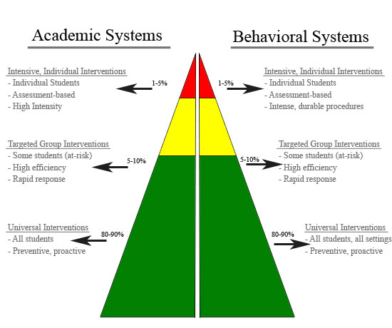
Tier 2 Behavior Support
Email me your concerns
Begin MTSS
Behavior Observation
FBA
BIP
PBS
Small Group Counseling

Slide 22
Small Group Counseling
Focusing on those students identified by teachers and staff as “at risk.”
Behavior Support and Counseling
Small Group
10 week courses

Slide 23
What is Positive Behavior Support?
“Positive behavior support (PBS) involves the changing situations and events that people with problem behaviors experience in order to reduce the likelihood that problem behaviors will occur and increase social, personal, and professional quality in their lives.”
Association for Positive Behavior Support
Research Based
Designed to improve quality of life.

Slide 24
Characteristics of PBS
Person centered planning
Collaborative teaming
Functional behavior assessment
Hypothesis development
Multi-component planning
Evaluation
Systems change

Slide 25
What does this look like at Galileo?
Individual Goals for each student
Daily Point Goal
Positive Reinforcement if goal is achieved
Goal tracking and daily monitoring
Evaluation

Slide 26
Evaluation
Data shows inconsistency in behavior. This intervention may not be enough for this student to be successful.

Slide 27
Tier 3 Behavior Support
Individual Monitoring
ESE Groups
Social Skills Groups
Student Study Data Review
Possible Referral for Exception Student Education

Slide 28
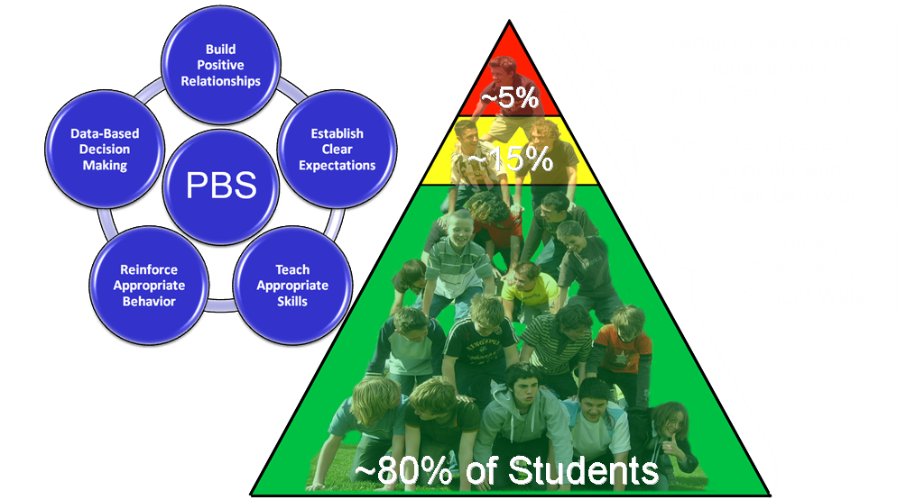
What this should look like…

