Slide 1
Galileo in Action: A Brief Overview of Curriculum and Culture

Slide 2
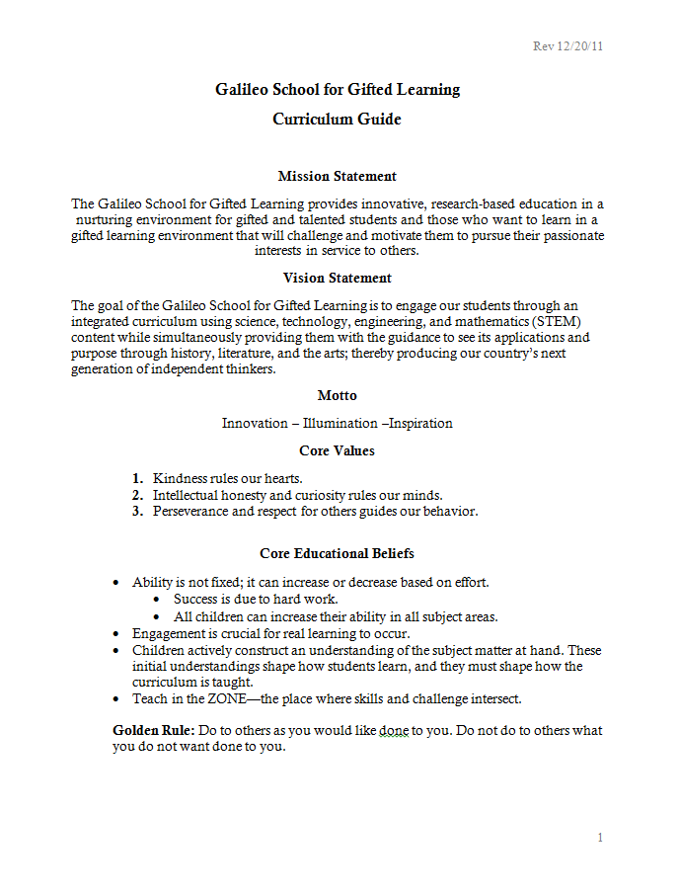
Curriculum Overview
Our curriculum is driven by the Curriculum Guide located on the Galileo Website.
http://www.galileogiftedschool.org/site_res_view_folder.aspx?id=0019eb8a-09e0-4364-a5c7-f1703a7c816d

Slide 3
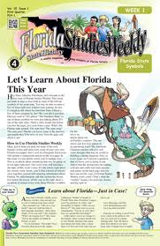
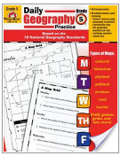
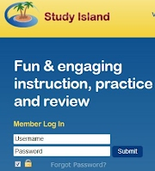
School Wide Curriculum Overview
https://sites.google.com/site/pathwaystocreativity/Home

Slide 4
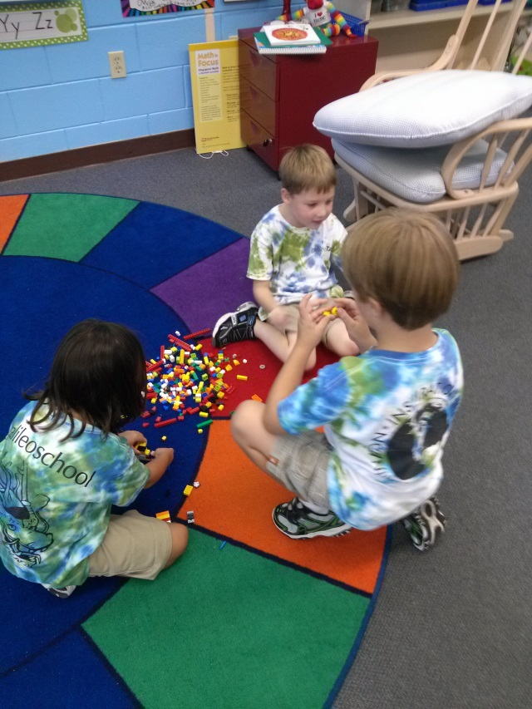
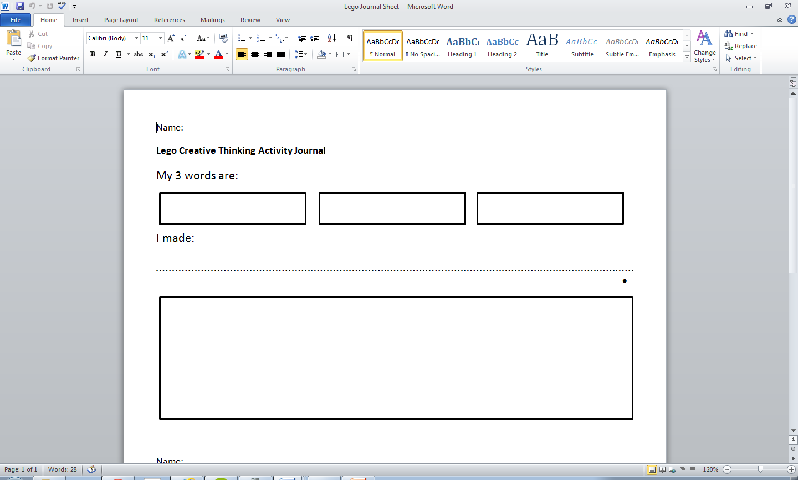
Lego Creative Thinking Activity
monkey, clip, grow

Slide 5
Math In Focus: 60 Minutes Each Day
Vocabulary/ background information
Focus on critical thinking
Uses manipulatives in every lesson
No repeated content/skill from grade to grade
Manipulatives
Visual
Abstract

Slide 6
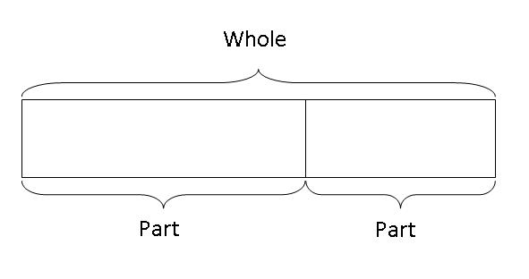
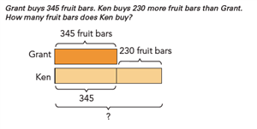
Bar Models

Slide 7
Language Arts - Primary: 90 Minutes Each Day
Whole Group Lessons
Center Rotations
Making Meaning
Junior Great Books
Skill Building Picture Books
Vocabulary
Phonics Lessons
Sight Words
Handwriting
Spelling Practice
Guided Reading – Small Group
Independent Reading
Listening to Reading
Word Work
Writing/Handwriting
21st Century Skills
Phonemic Awareness
Notes:
Read aloud stories, Comprehension, Critical thinking, Thoughtful discussion, Art activities, Writing activities

Slide 8
Language Arts - Intermediate: 90 Minutes Each Day
Literacy Skills: Independent/Small Groups
Whole Group Lessons
Novel Study
Guided Reading
Independent Daily Reading
21st Century Skills
Spelling/Vocabulary
Focus on Creativity
Making Meaning
Being A Writer/ Writer’s Workshop

Slide 9
Science/Social Studies: 60 Minutes Each Day
Science
Social Studies
Interactive Science
Uses a workbook that students write in
Hands on experiments
Online components for classroom use
Social Studies Weekly
A periodical format
Covers all Florida standards for S.S.
Online components for classroom use

Slide 10
Project Based Learning: 50 Minutes During Weeks With No Creative Productivity
Focuses on:
Creating products for any curriculum area;
21st Century Skills;
Research in topics of further interest;
Exploring enrichment areas.
Special Enrichment Days:
This time is also used for special enrichment activities based on special “days” of the week or month.

Slide 11
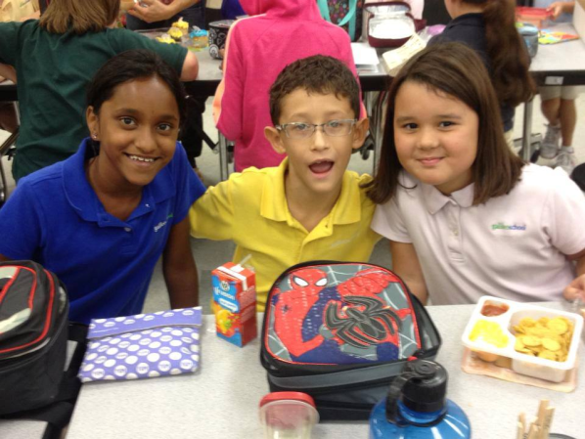
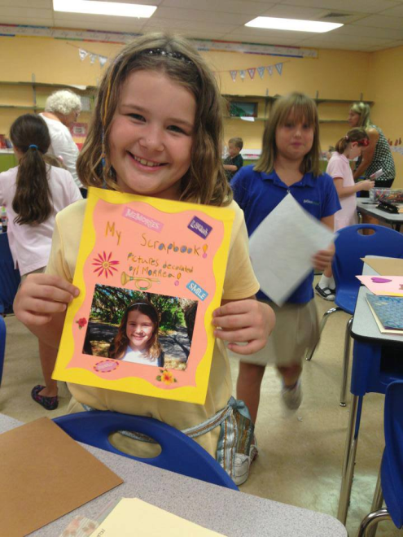
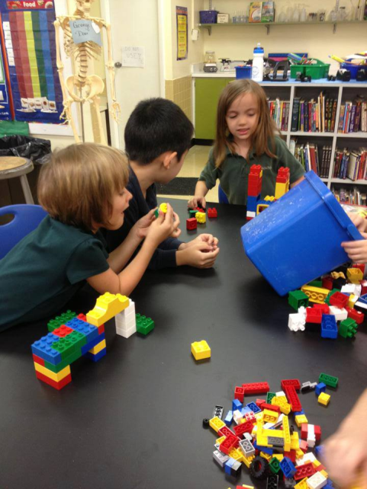
Other Parts of Our Day
Music
PE
Art Expressions
Media Center
Lunch Clubs

Slide 12
Technology
Multiple online learning resources are used at Galileo:
Renzulli Learning
Reading Eggs/Reading Eggspress
Study Island
Middlebury Interactive Language Learning
Kahn Academy
Word Processing/Presentation Software (Microsoft, Prezi)
IPAD Lab, 40+ Seat Computer Lab, Computers in Each Classroom

Slide 13
Questions?

Slide 14
Thank you for coming!

