Slide 1
Parenting in a Pandemic
A Parent Empowerment Workshop
By Amanda Romano

Slide 2
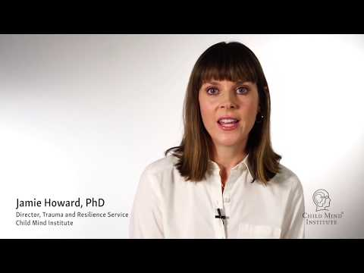
An Introduction Video

Slide 3
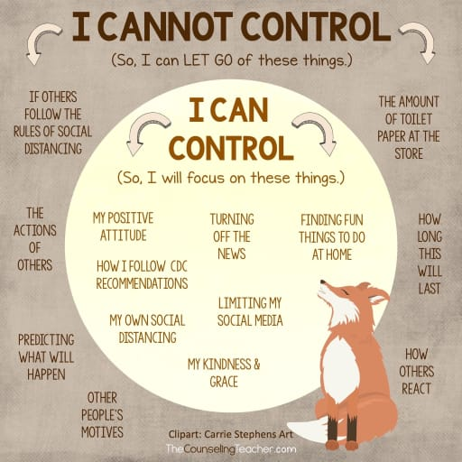
Be a role model.
Children will react to and follow your directions. They learn from your example and feed off your energy.

Slide 4
Be aware of how you talk about Covid-19 and its effects on life and school.
Your discussion about COVID-19 can increase or decrease your child's fear. If true, remind your child that your family is healthy, and you are going to do everything within your power to keep loved ones safe and well. Carefully listen or have them draw or write out their thoughts and feelings and respond with truth and reassurance.

Slide 5
Explain Social Distancing and Mask Mandates
Tell your child that your family and our school is following the guidelines of the Centers for Disease Control and Prevention (CDC), which include social distancing and mask mandates. Social distancing means staying away from others until the risk of contracting COVID-19 is under control.
Showing older children the "flatten the curve" charts will help them grasp the significance of social distancing. Explain that while we don't know how long it will take to "flatten the curve" to reduce the number of those infected, we do know that this is a critical time—we must follow the guidelines of health experts to do our part.

Slide 6
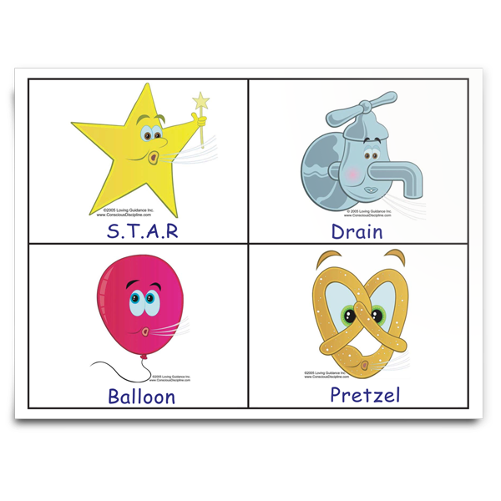
Implement Conscious Discipline at home
Conscious Discipline is the research-backed, evidence-based Social Emotional curriculum we use at Galileo to help students learn to name and regulate their emotions, manage stress, resolve conflict, and develop healthy behaviors.
Conscious Discipline: Home
Breathing Strategies for calming the nervous system.

Slide 7
Establish and Maintain a Daily Routine
Keeping a regular schedule provides a sense of control, predictability, calm, and well-being. It also helps children and other family members respect others’ need for quiet or uninterrupted time.
Have consistent bedtimes and get up at the same time, Monday through Friday.
Structure the day for learning, free time, healthy meals and snacks, and physical activity.
Allow flexibility in the schedule—it’s okay to adapt based on your day.

Slide 8
Monitor Television Viewing and Social Media
Parents should monitor television, internet, and social media viewing—both for themselves and their children. Watching continual updates on COVID-19 may increase fear and anxiety. Developmentally inappropriate information, or information designed for adults, can also cause anxiety or confusion, particularly in young children.
Dispel rumors and inaccurate information. Explain to your child that many stories about COVID-19 on the internet may include rumors and inaccurate information. Older children, in particular, may be accessing a great deal of information online and from friends that contain inaccuracies. Talk to your child about factual disease information.

Slide 9
Take Time to Talk
Let your children's questions guide you.
Answer their questions truthfully, but don't offer unnecessary details or facts. Don't avoid giving them the information that experts indicate as crucial to your children's well-being. Often, children and youth do not talk about their concerns because they are confused or don't want to worry loved ones. Younger children absorb scary information in waves. They ask questions, listen, play, and then repeat the cycle. Children always feel empowered if they can control some aspects of their life. A sense of control reduces fear.

Slide 10
Keep Explanations Age-Appropriate
Early elementary school children.
Provide brief, simple information that balances COVID-19 facts with appropriate reassurances that adults are there to help keep them healthy and to take care of them if they do get sick. Give simple examples of the steps people make every day to stop germs and stay healthy, such as washing hands. Use language such as "adults are working hard to keep you safe."

Slide 11
Upper elementary and early middle school children
This age group often is more vocal in asking questions about whether they indeed are safe and what will happen if COVID-19 spreads in their area. They may need assistance separating reality from rumor and fantasy. Discuss the efforts national, state, and community leaders are taking to prevent germs from spreading.
Upper middle and high school students
Issues can be discussed in more depth. Refer them to appropriate sources of COVID-19 facts. Provide honest, accurate, and factual information about the current status of COVID-19. Engage them in decision-making about family plans, scheduling, and helping with chores at home.

Slide 12
Stay Connected to School
Stay in touch. Find out how the school is communicating with families and students. Be sure to read any communications you receive. Check with your children, particularly older ones, as they may be receiving information directly that would be helpful for you to know.
Connect with school staff. Reach out to your child’s teacher and other relevant school staff if you have concerns about their coping abilities and keeping up with assignments or activities.
We are all on the same team!

Slide 13
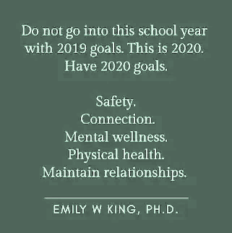
Set Reasonable Expectations
We want your child to learn as much as possible, but it’s also important to realize that kids have likely experienced some academic or social regression as a result of being isolated and out of school.
Stay focused on the big picture!

Slide 14
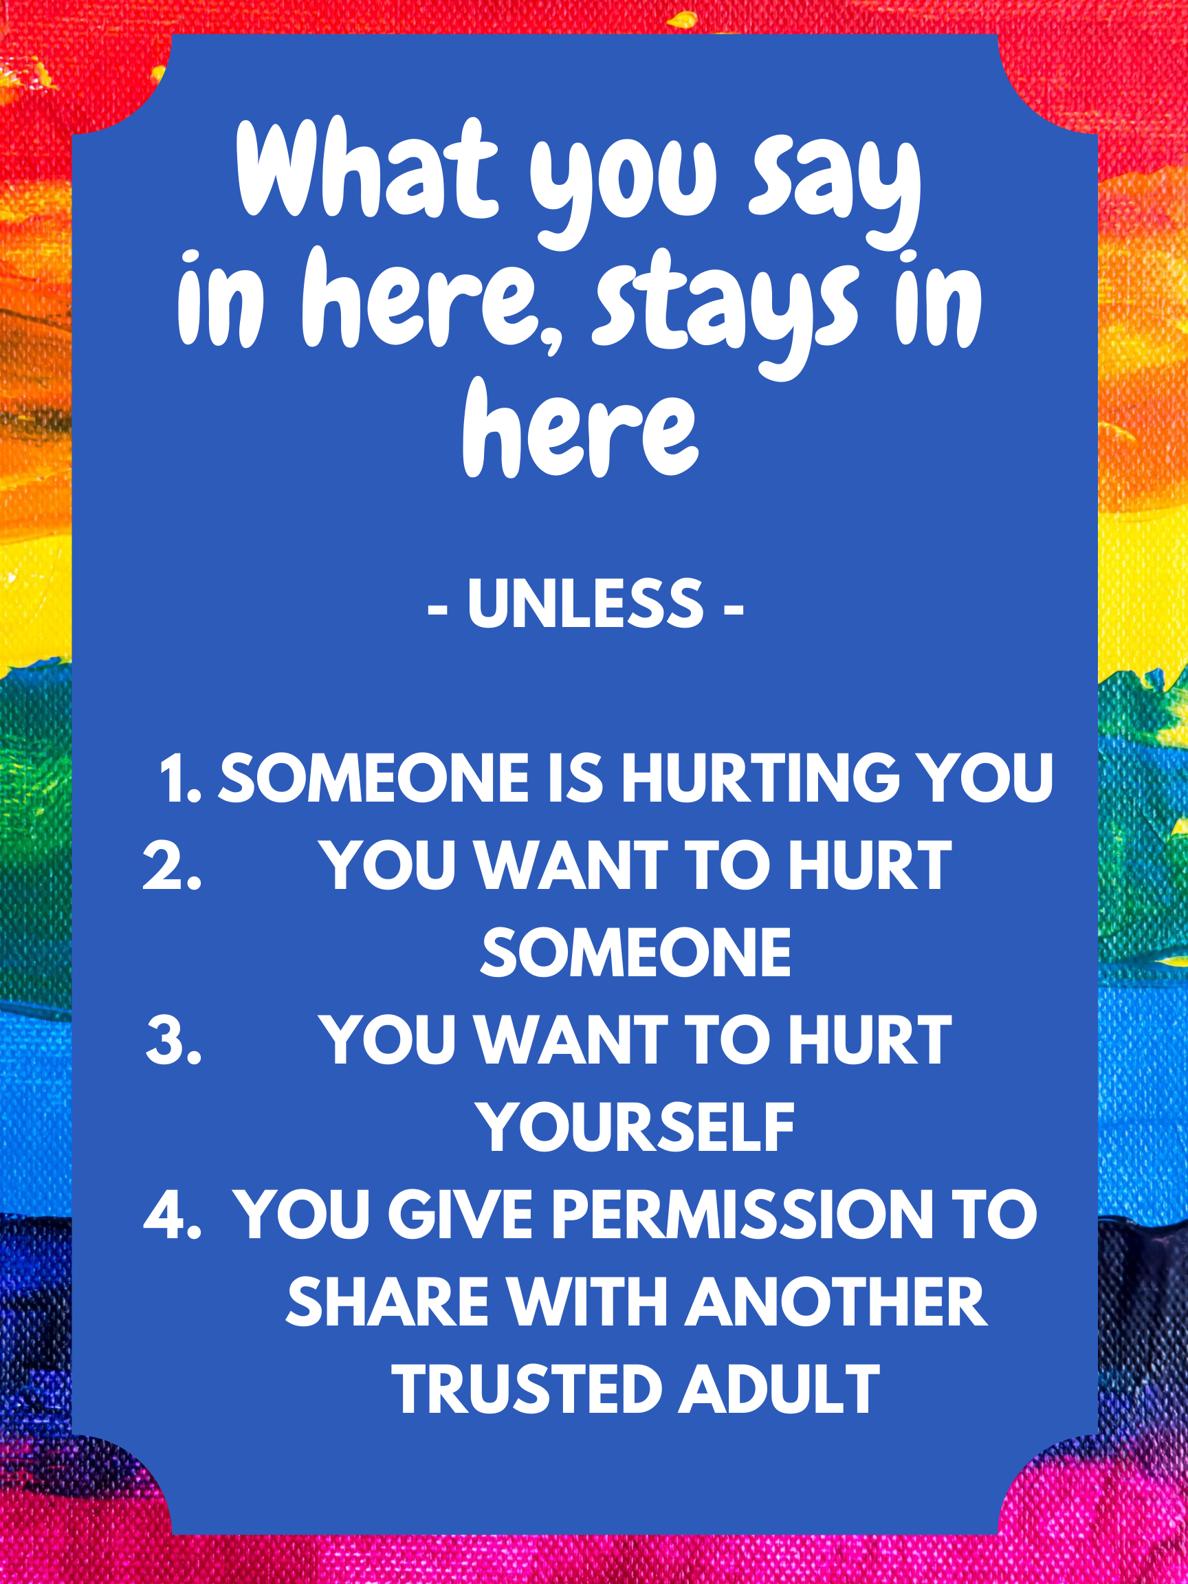
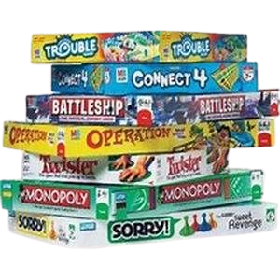
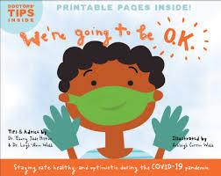
Welcome. We are your Galileo Mental Health Counselors! I am Ms. Hilligas.
And, I am Mrs. Barnes. Feel free to click around!

Slide 15
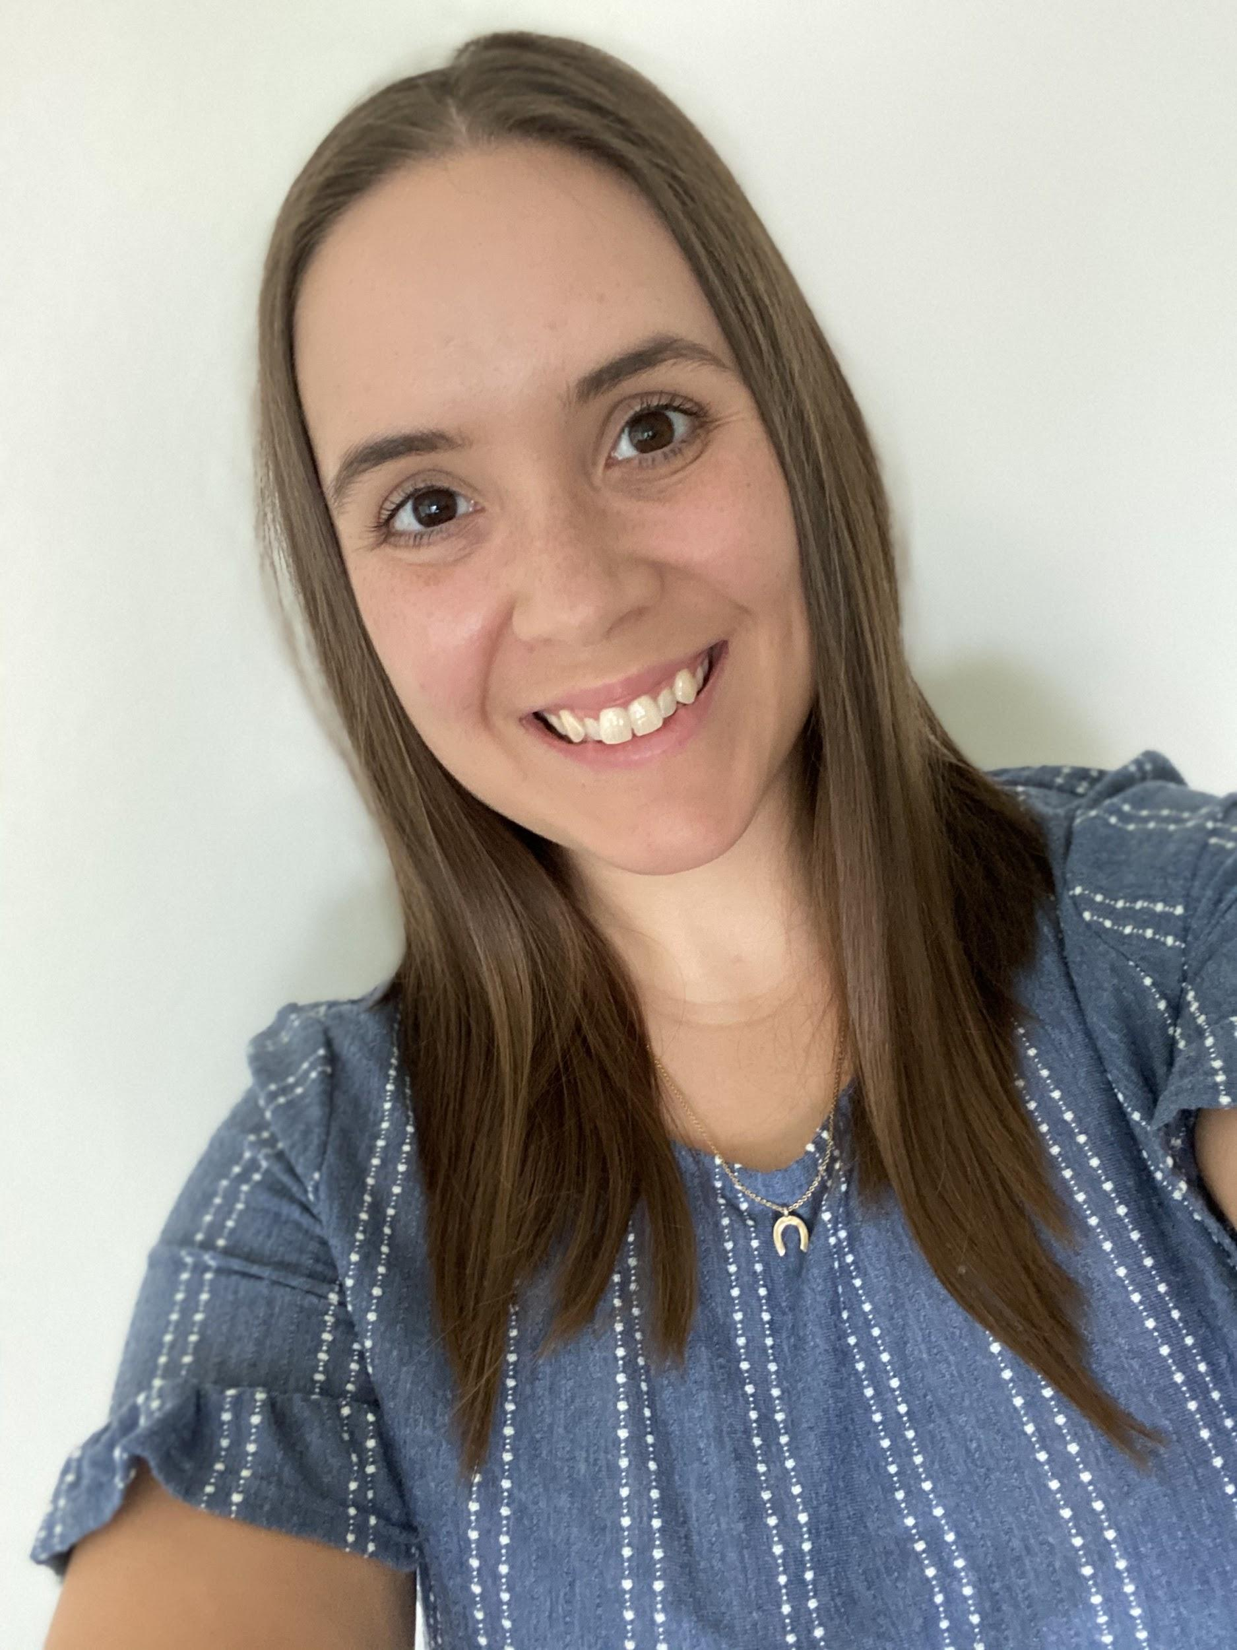
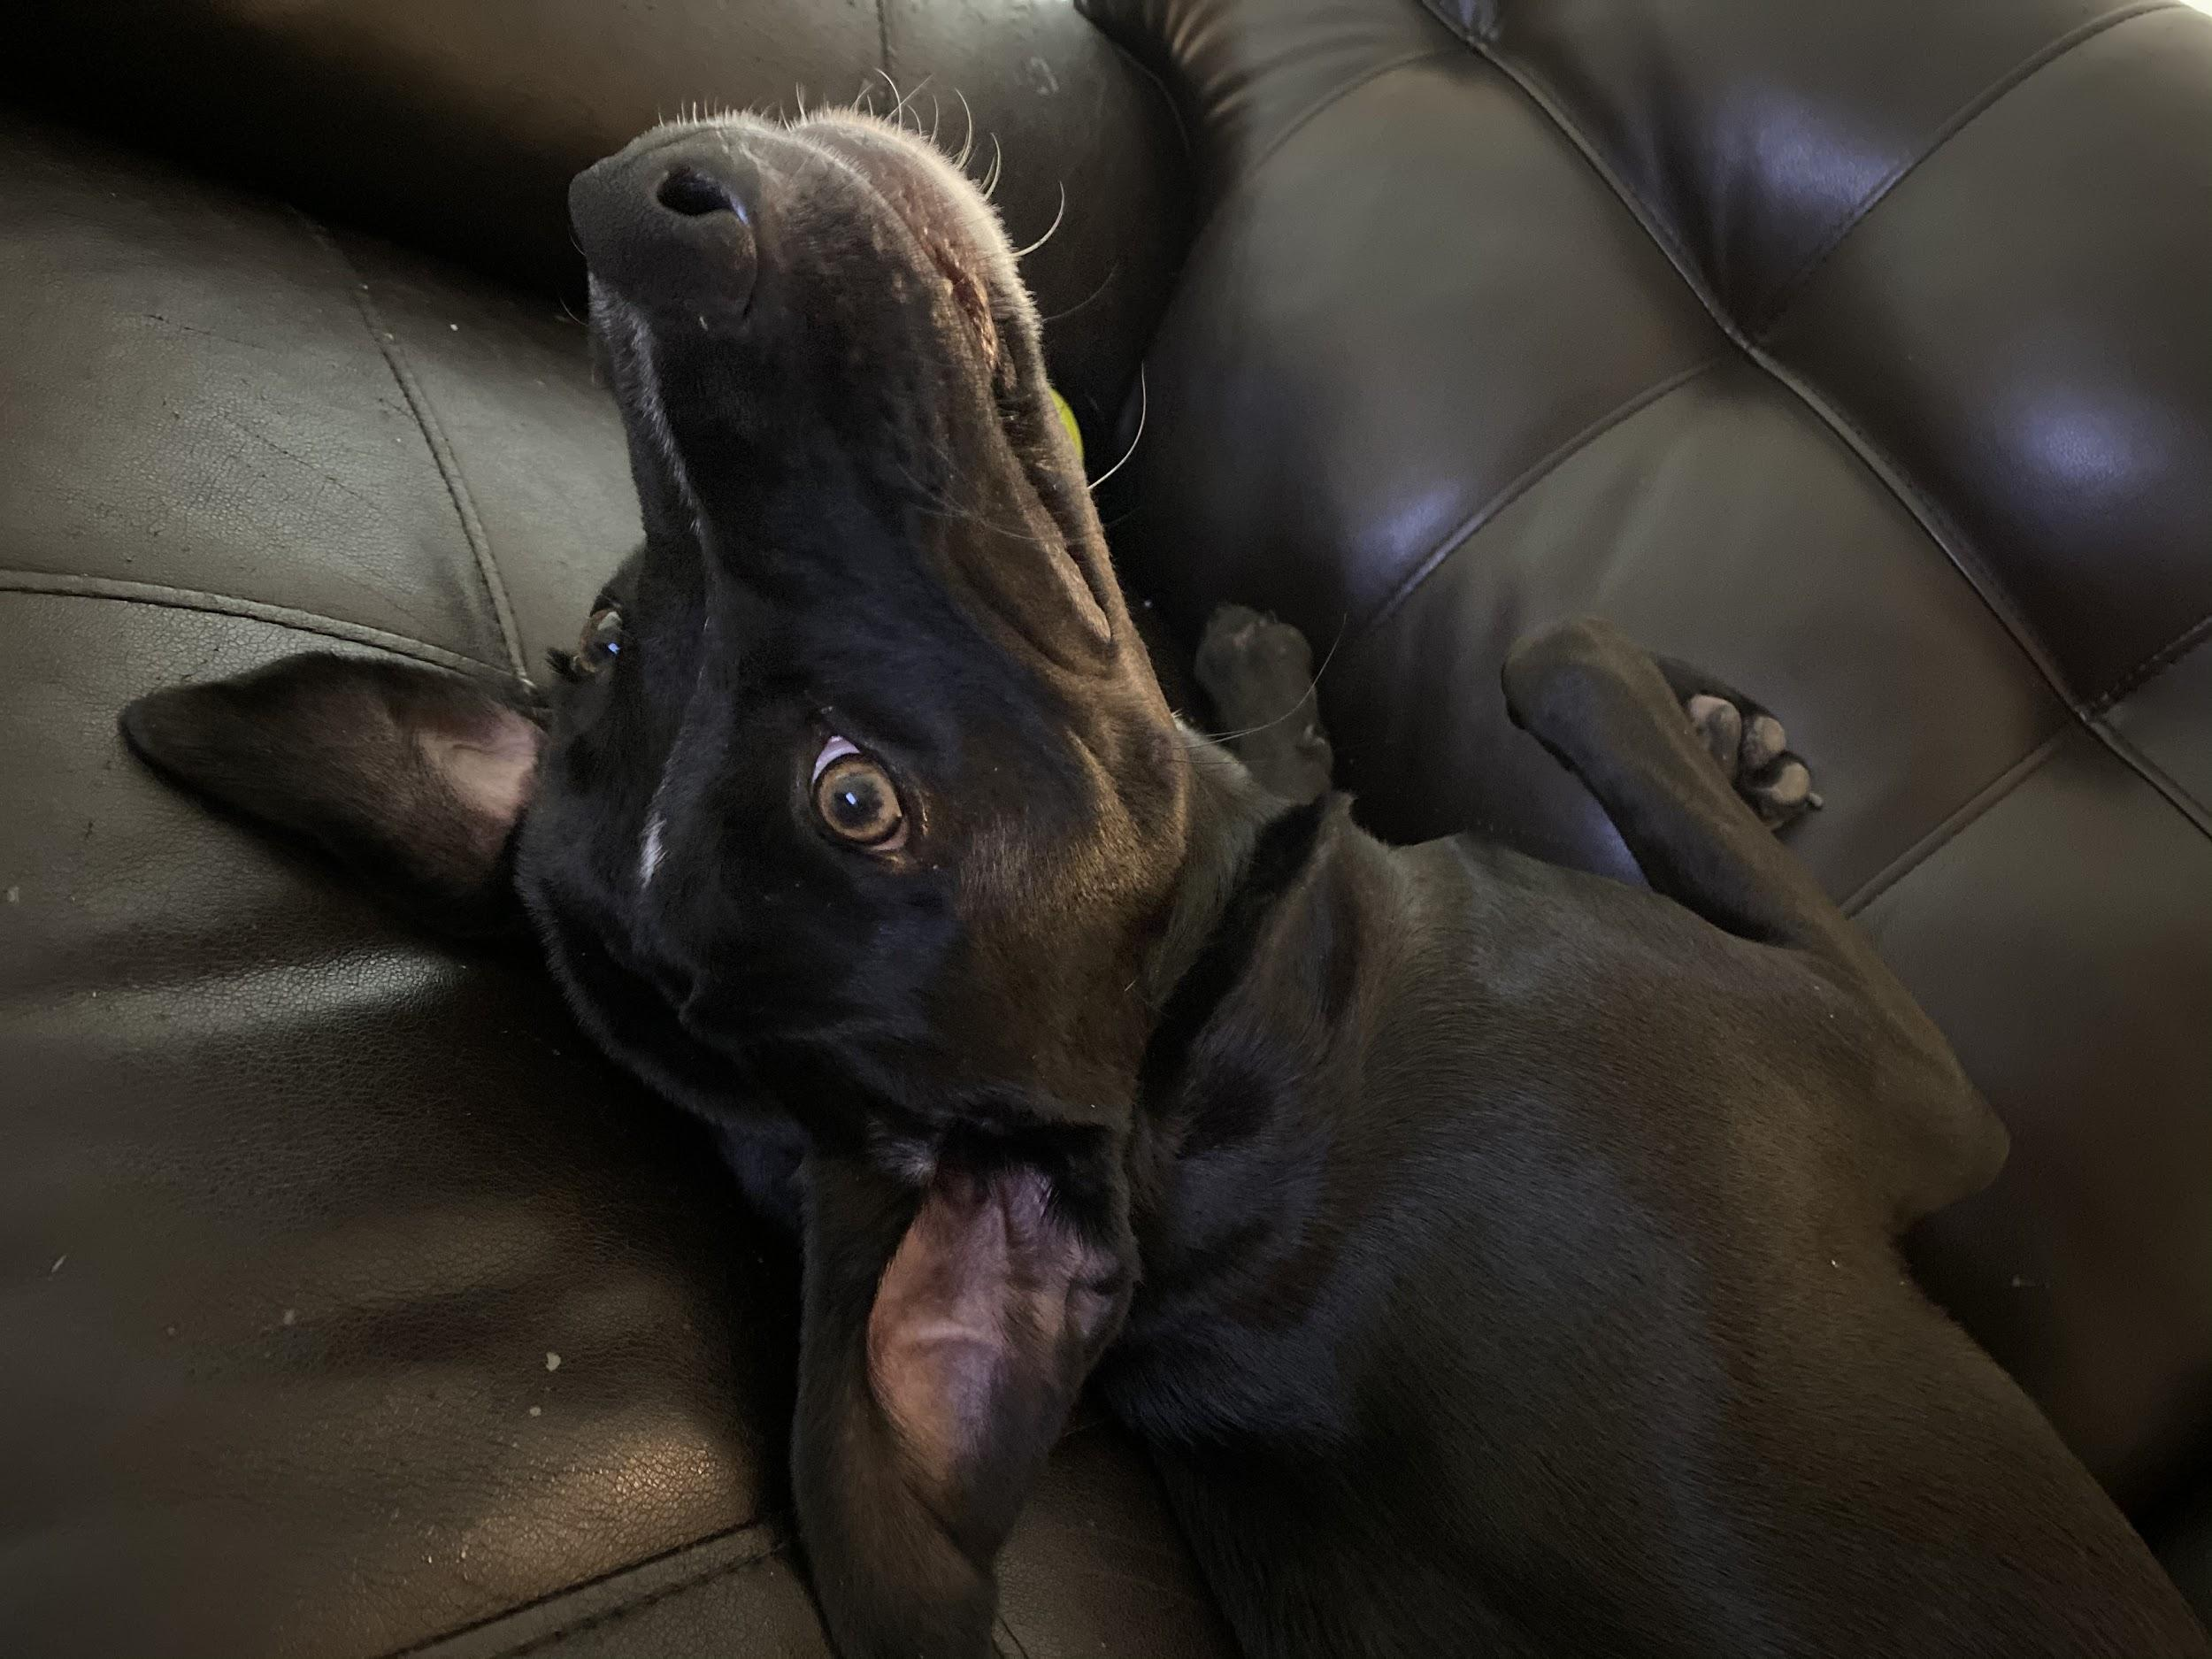
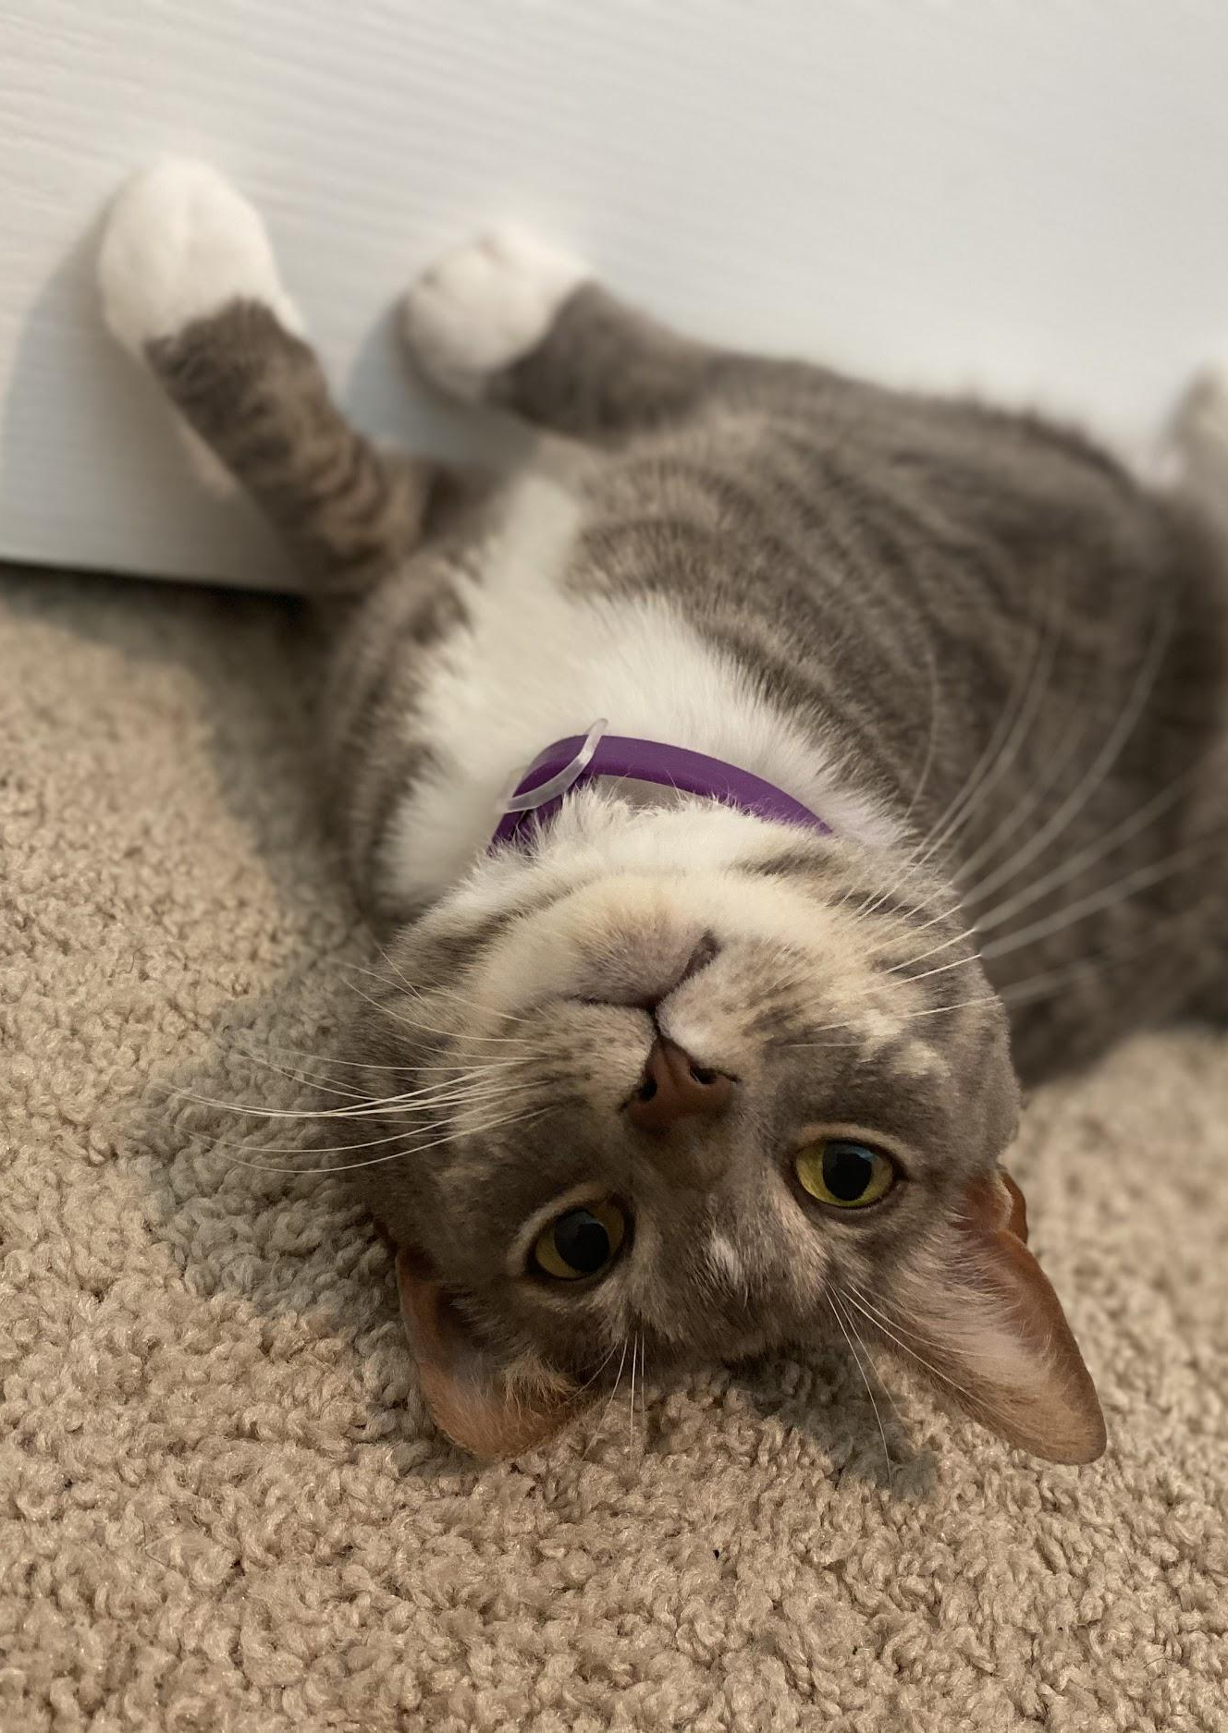
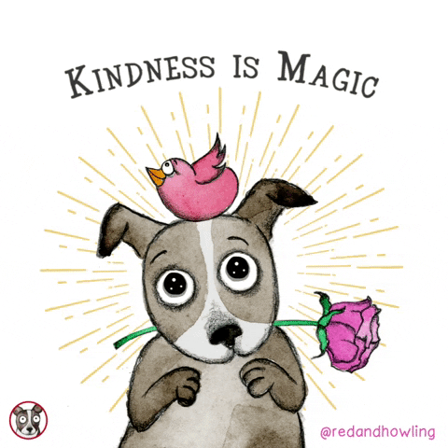
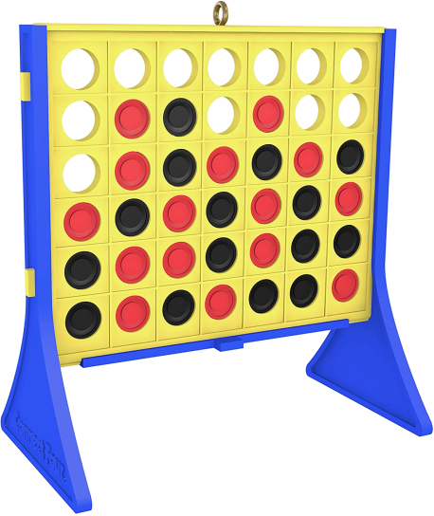
Meet Ms. Hilligas
<< Back

Slide 16
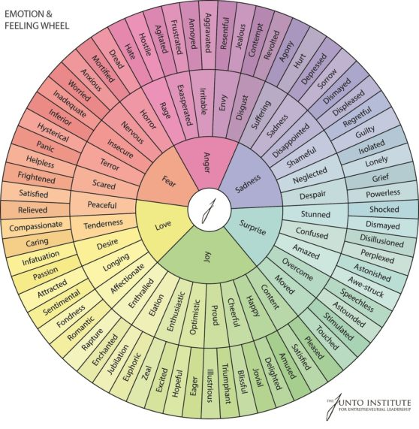
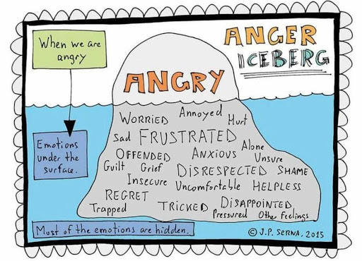
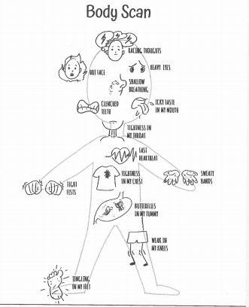
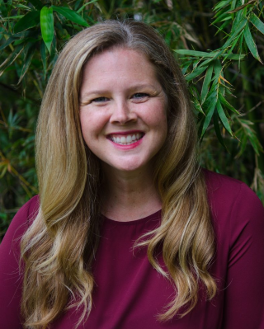
Welcome!
I’m Mrs. Barnes
Virtual Mental Health Support Service Provider
<< Back

Slide 17
Virtual Drop-in Groups
Group will cover anxiety, back-to-school, and Covid-19
Elementary - Wednesday 11:30 am -12 pm
Join with Google Meet Link:
meet.google.com/jep-qmnu-iog
Middle School - Friday 12:15-12:45 pm
meet.google.com/njr-muoz-nuc
*Galileo students only. Must log in with Galileo Google account.
Please mute when not speaking.
We can not guarantee confidentiality. Participation is voluntary .

Slide 18
One last point…
Cut yourself some slack. This is hard.
The most important thing to do is the one you already do without even trying...loving your kiddo.

Slide 19
Upcoming Parent Empowerment Workshops:
October 2 - Organizational Strategies for Students with Amanda Romano
November 6 - Recognizing and Addressing Mental Health Issues with Ms. Hilligas & Mrs. Barnes, Mental Health Counselors
December 4 - Developing a Growth Mindset with Amanda Romano

Slide 20
Thank you for joining me!
Time for questions/discussion

